Slide 1
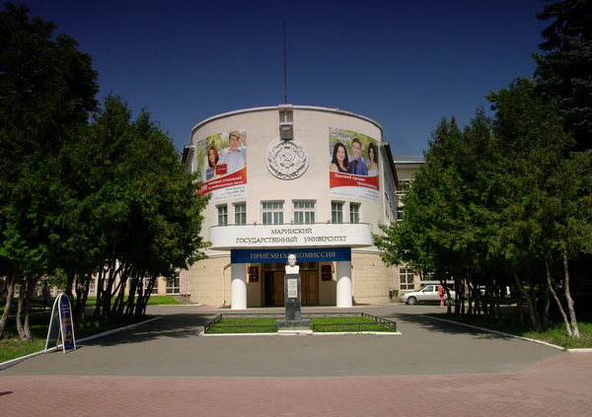
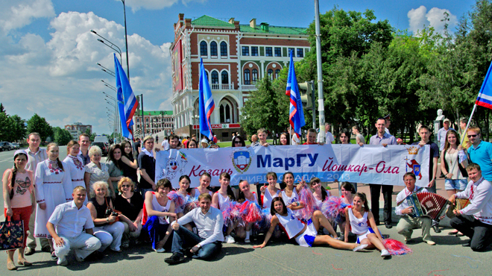
MARI STATE UNIVERSITY

Slide 2
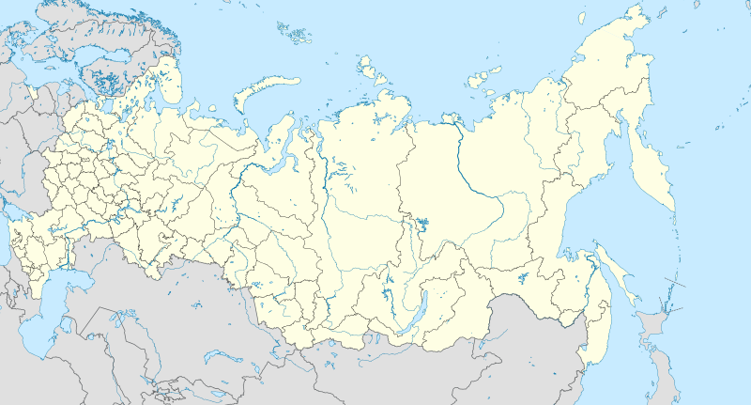
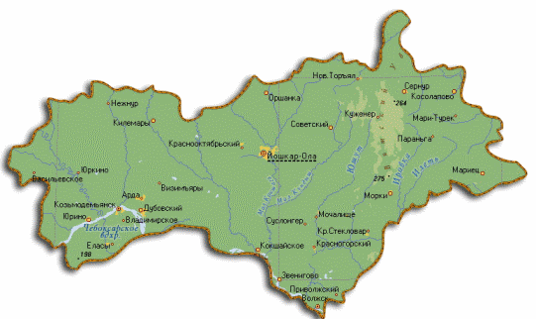
Located in Yoshkar-Ola (Mari El Republic)
Established in 1972

Slide 3
MarSU
10 Faculties, 6 Institutes (including Agrarian Technological Institute).
More then 100 higher educational programs, more than 40 postgraduated programs
Total amount of students: more 9000.
Staff: 850, more than 100 with Doctor's and Professor's degree; more than 500 with Kandidat's and Assistant Professor's degree

Slide 4
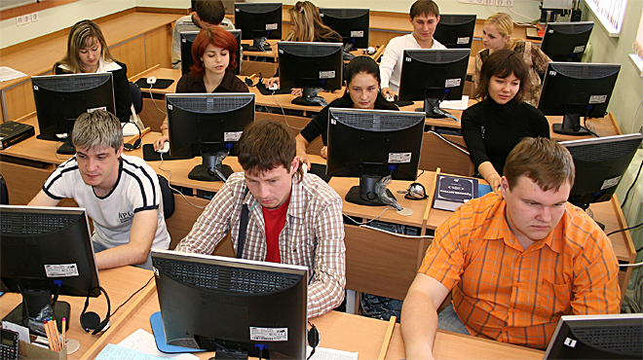
ACTIVITIES
Natural sciences (mathematics, physics, mechanics, biology, chemistry)
Pedagogical education
Economics
Law
Culture and Arts
Agricultural programs

Slide 5
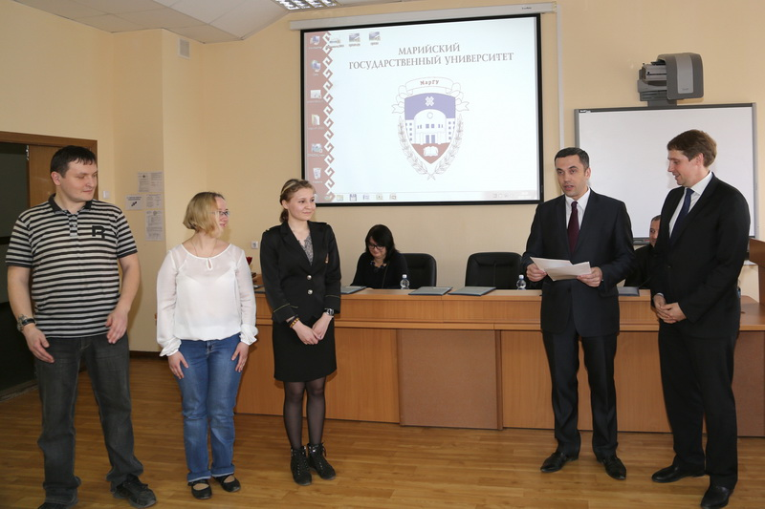
INSTITUTES AND FACULTIES
Institute of Agricultural Technologies
Institute of Economics, Management and Finances
Institute of National Culture and Intercultural Communication
Institute of Additional Professional Education
Institute of Pedagogics and Psychology
Faculty of Physics and Mathematics
Faculty of Foreign Languages
Faculty of Law
Faculty of History and Philology
Faculty of Physical Education, Sport and Tourism
Faculty of Technology and Professional Studies
Faculty of Biology and Chemistry
Faculty of Electrical Engineering

Slide 6
Thank you for your attention!

